Slide 1

DWM Audit
Presentation

Slide 2
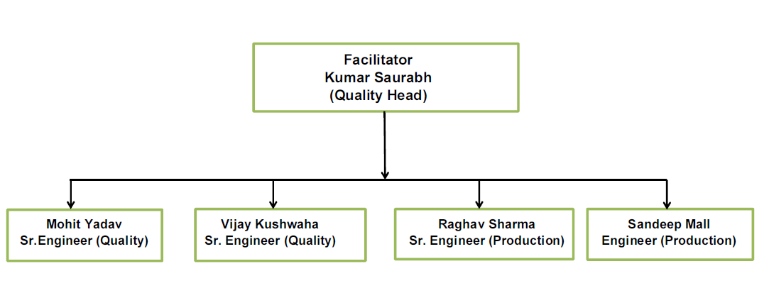
List of DWM Auditor

Slide 3
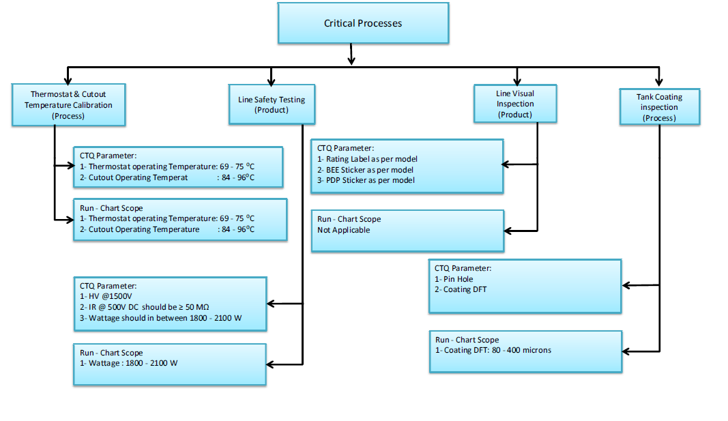
Critical Process & Scope of Run Chart

Slide 4
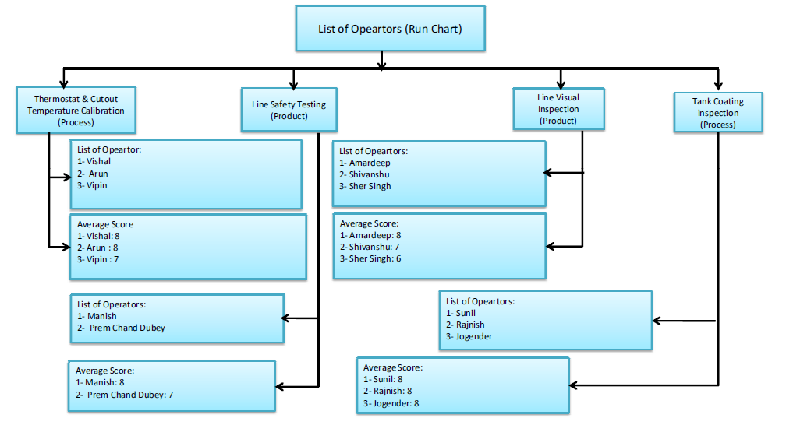
List of Operators & Score card in Run Chart

Slide 5
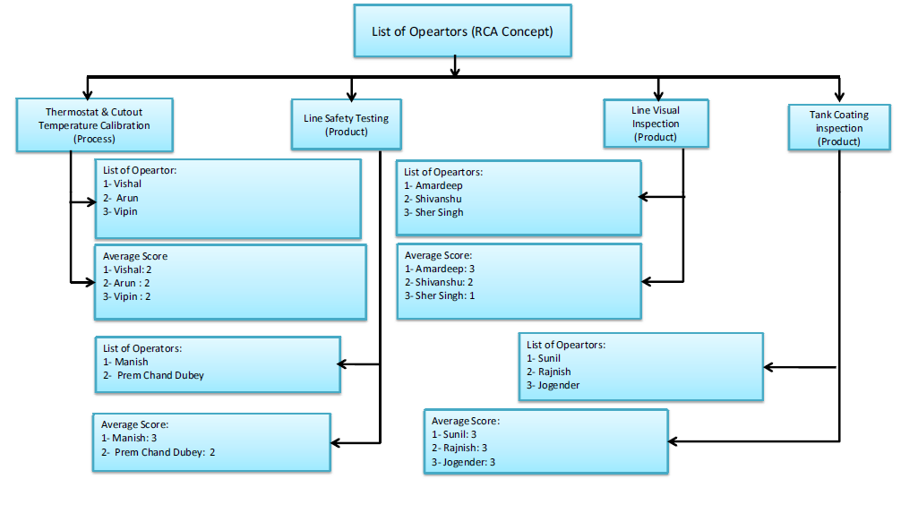
List of Operators & Score card in RCA Concept

Slide 6
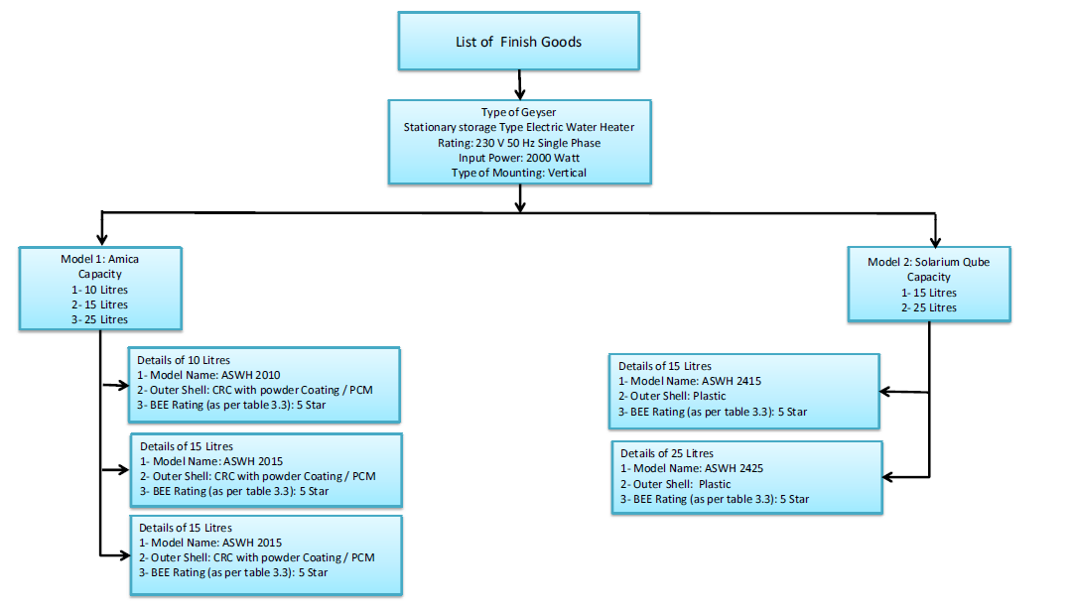
List of finish Goods

Slide 7
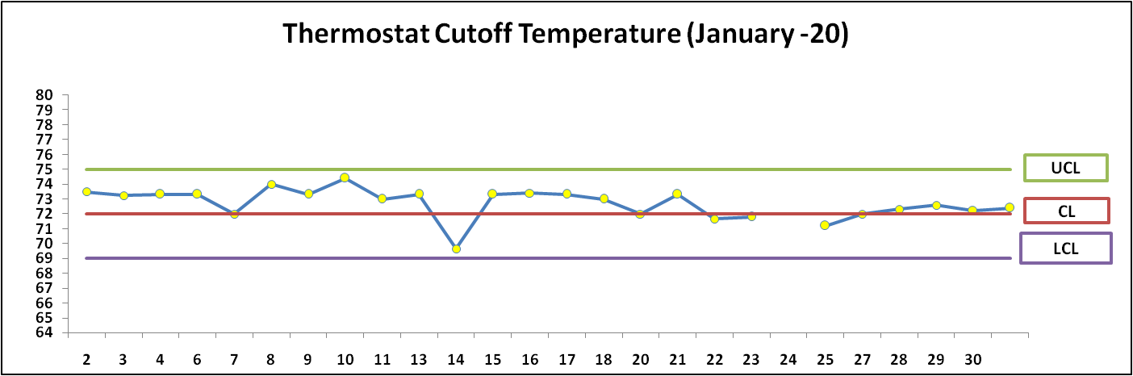
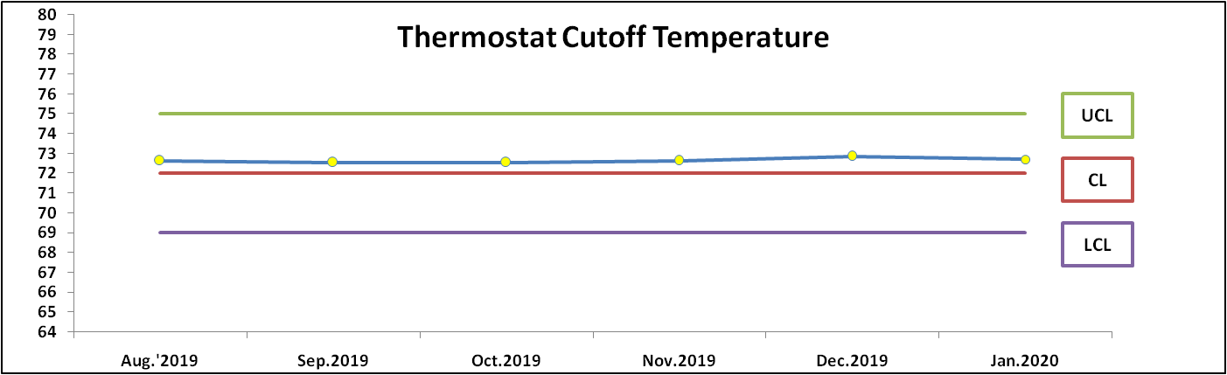
Daily & Monthly Run Chart Monitoring

Slide 8
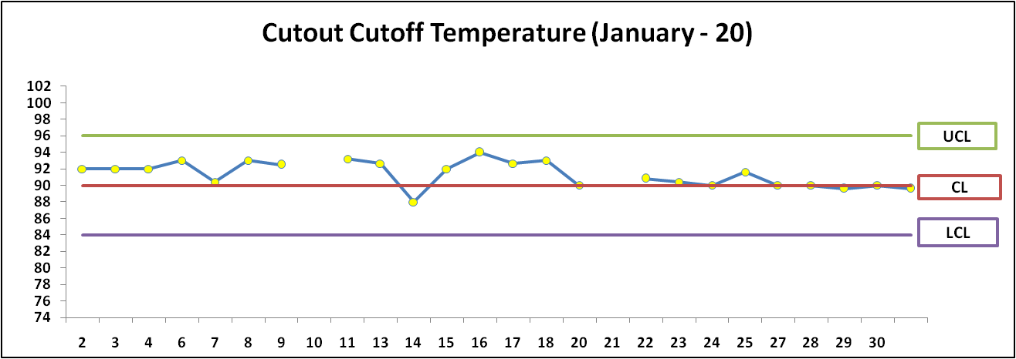
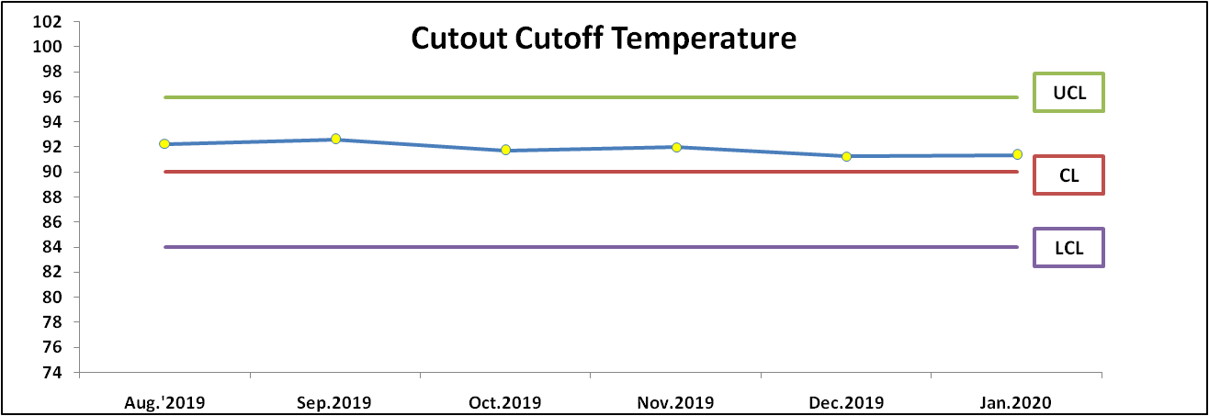
Daily & Monthly Run Chart Monitoring

Slide 9
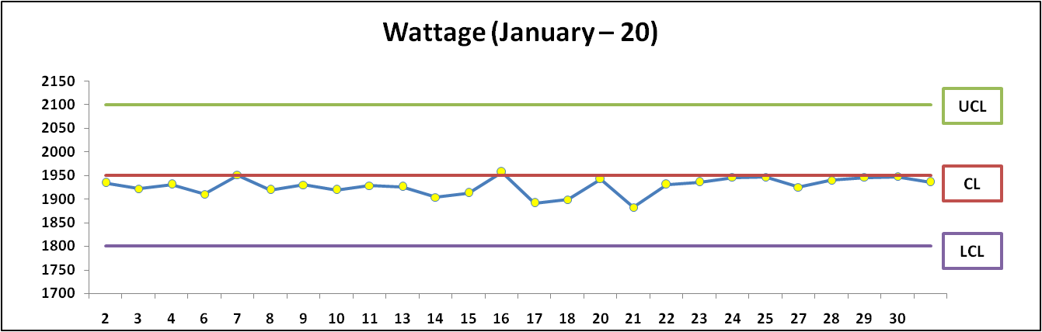
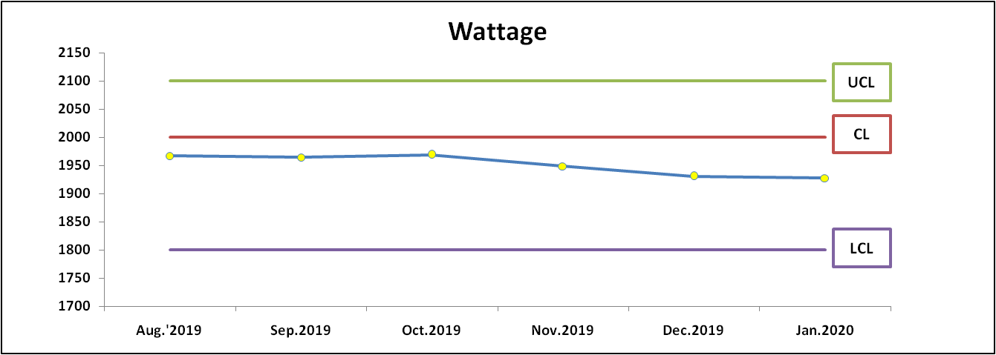
Daily & Monthly Run Chart Monitoring

Slide 10
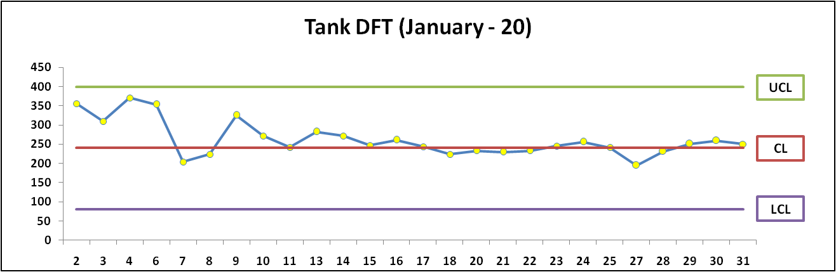
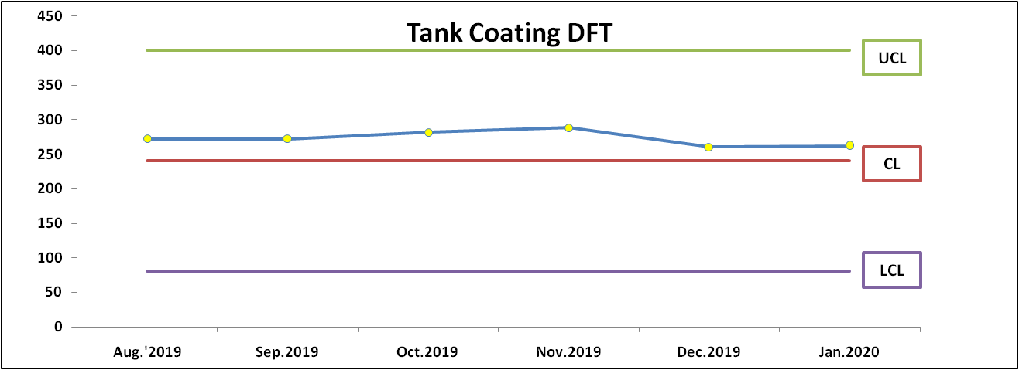
Daily & Monthly Run Chart Monitoring

Slide 11
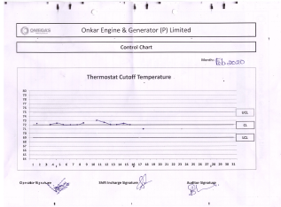
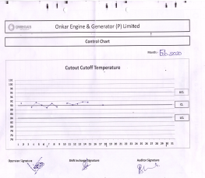
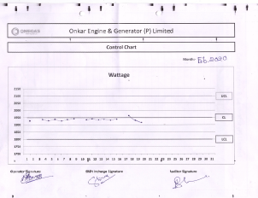
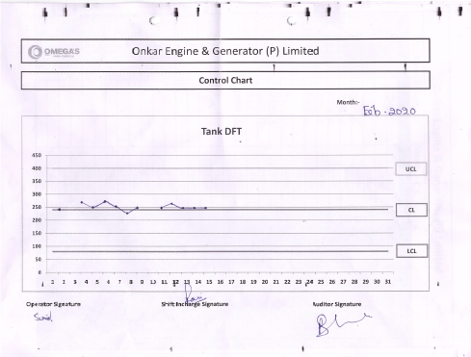
Daily & Monthly Run Chart Monitoring

Slide 12
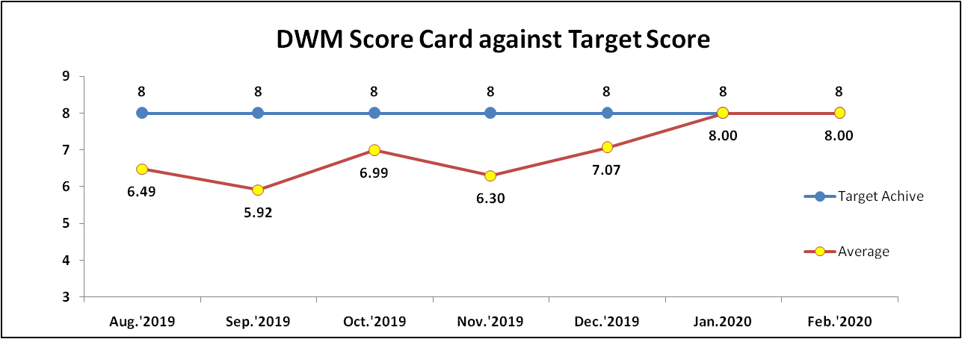
DWM Monthly Score Card
Month | Causes | Action
Aug.'2019 | New Project Lack of awareness/Training | Training Imparted & Improvement seen
Sep.'2019 | Trained People Left to the Company | New joining Imparted training
Oct.'2019 | 1-Lab SOP 2-Visual Detection Sample | 1-LAB SOP in English 2-Visual Detection Sample Display at Assembly
Nov.'2019 | 1-Lack of Defect & Detection Analysis 2-Awarness about CAPA | 1-Training Imparted for Defect & Detection Analysis 2-Training Imparted for Awareness about CAPA
Dec.2019 | Separate Session for RCA Concept | weekly meeting scheduled on behalf of NC Observe in Process.

Slide 13
Thank you!!

